Slide 1
Lab 3: Arduino and Wireless

Slide 2
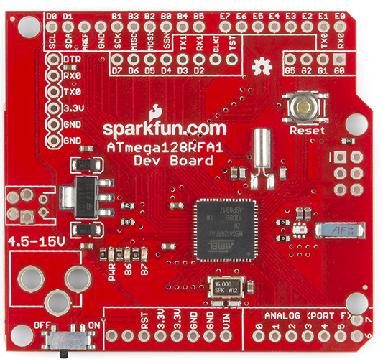
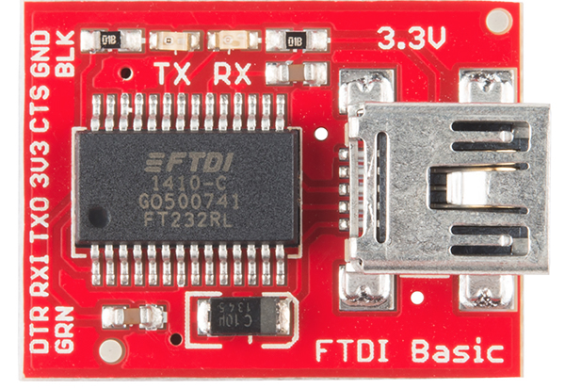
The “Red Board”
Nice breakout board for our microcontroller
Open source
Working radio design
Well-documented
Arduino compatible
Programmable with FTDI USB-to-serial converter
Key component of the controller
Reference design for the quadcopter’s flight computer and radio.

Slide 3
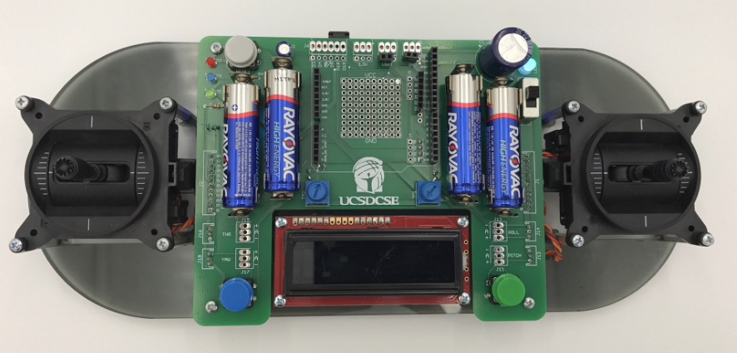
The Remote

Slide 4
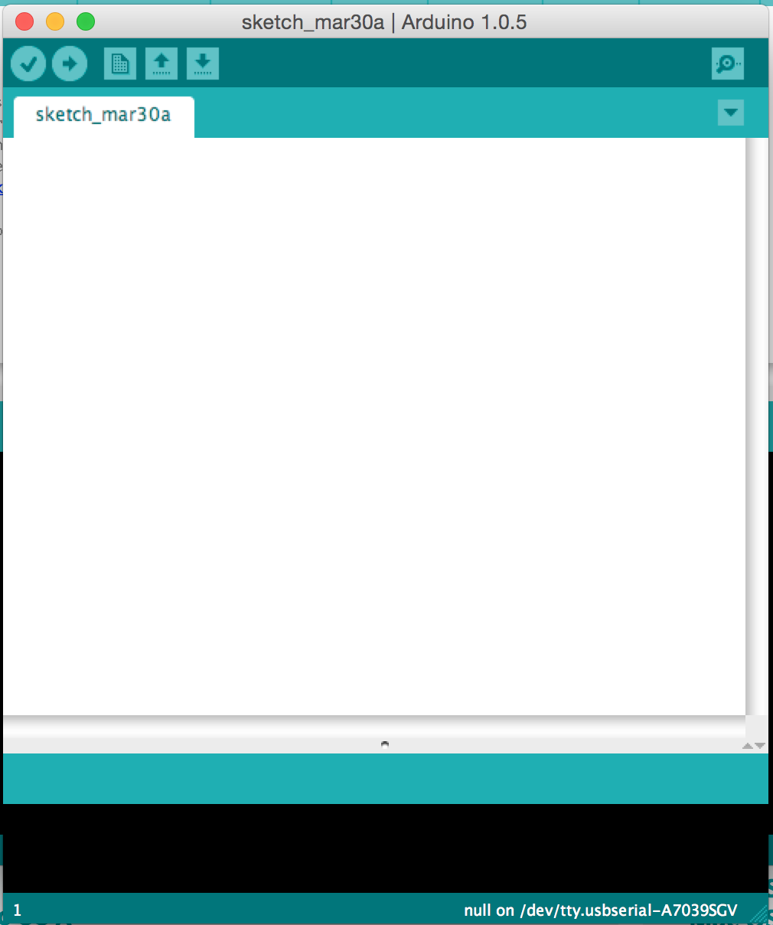
The Arduino IDE
User-friendly IDE for Arduino programming
Programming the microntroller is easy
Installation is easy
Alternatives
Eclipse for Arduino
Official AVR tools from Atmel
You can use them, but they aren’t supported by us.

Slide 6
Tasks
Get wireless working
Download, compile, and install a simple chat program that runs between two red boards.
Push its limits
Do some simple experiments to
Measure range, bandwidth, and the error rate

